Slide 1
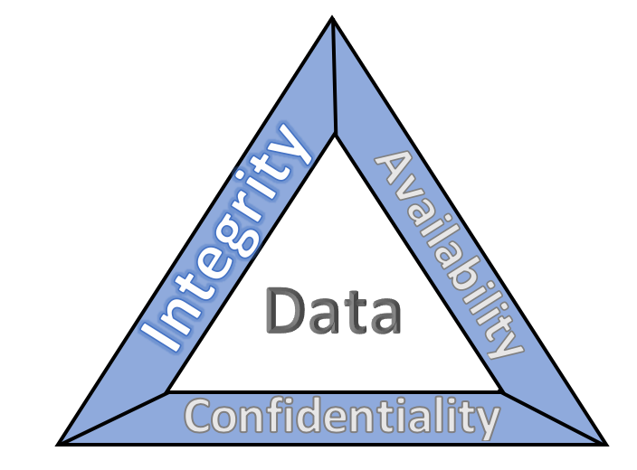
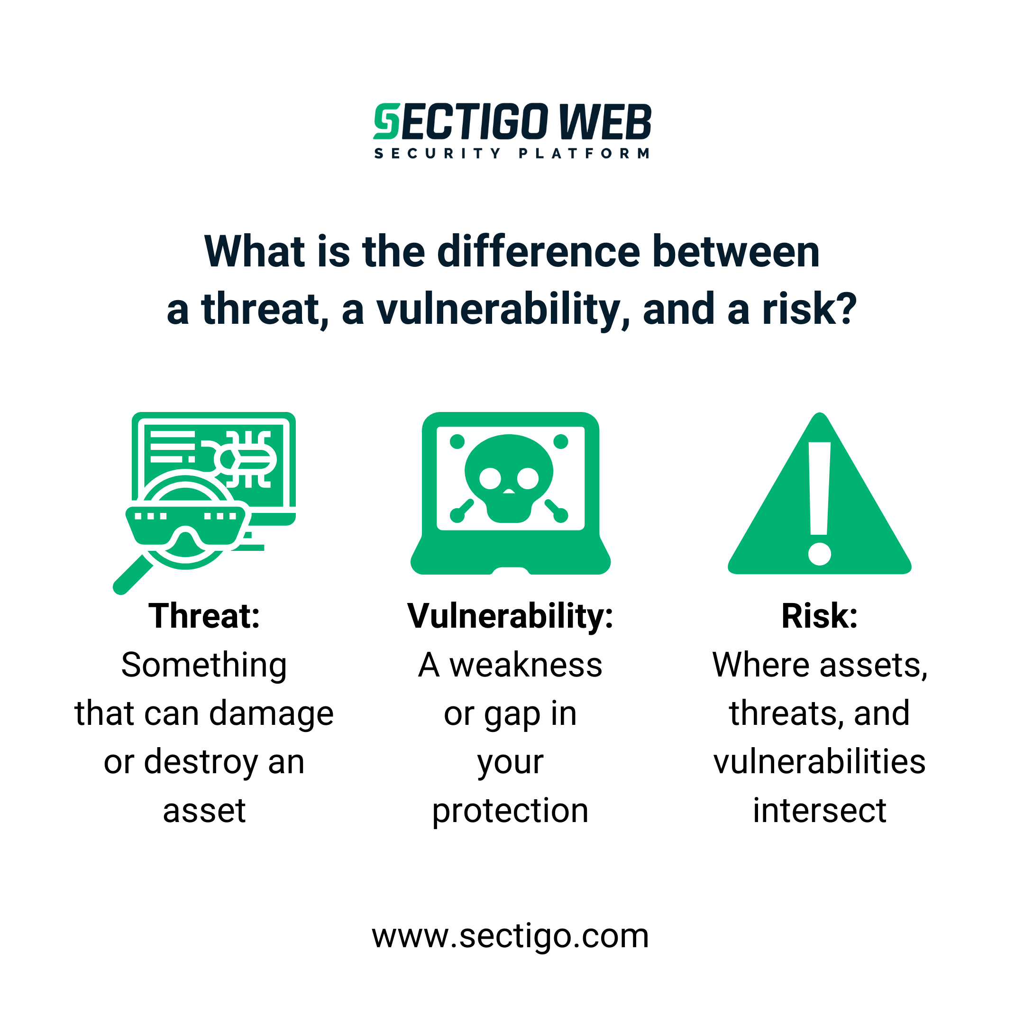
Threats, Vulnerabilities, and Risks… Oh my!

Slide 2
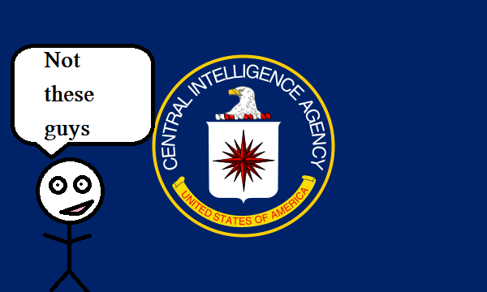
Agenda
CIA – No, not the feds
Threats
Vulnerabilities
Risks
  Math – Not really so much

Slide 3
CIA
Confidentiality – preserving authorized restrictions on information access and disclosure, including means for protecting personal privacy and proprietary information
Integrity — guarding against improper information modification or destruction and ensuring information non-repudiation and authenticity
Availability – ensuring timely and reliable access to and use of information
https://www.nccoe.nist.gov/publication/1800-25/VolA/index.html

Slide 4
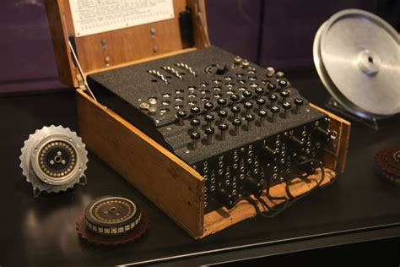
Confidentiality
Ensuring only authorized
people can access data
Encryption technology
Credential Access
NDAs, policies, etc.

Slide 5
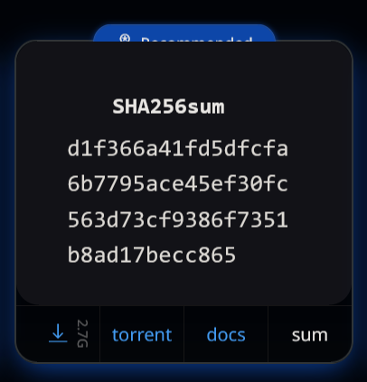

Integrity
Guarantee the data you have is what was intended
Hashing algorithms
Non-repudiation - Authenticity

Slide 6

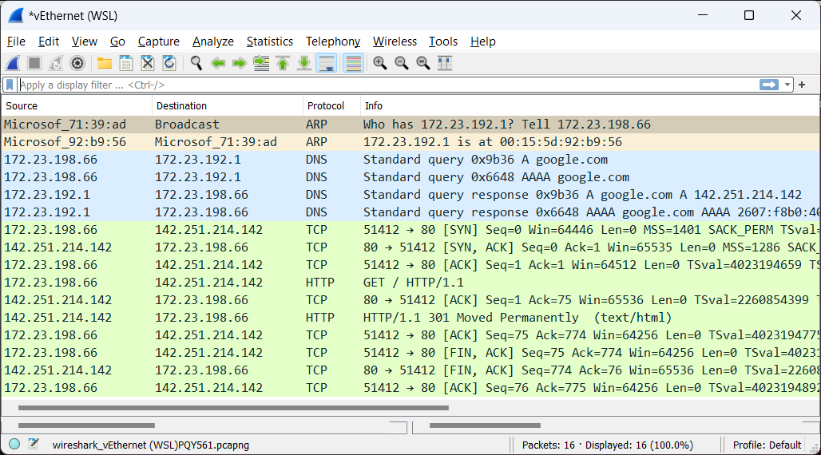
Availability
Ensuring data is actually
there for users to access
Service up-time
In a timely manner
Backups and
redundant systems
TCP and other
protocols

Slide 7
CIA is a Balancing Act

Slide 8

Threats
Anything that *CAN* cause harm to a system
Natural
Unintentional
Malicious
Who or what is
threatening us?
APTs, Employees,
hacktivists, script kiddies

Slide 9
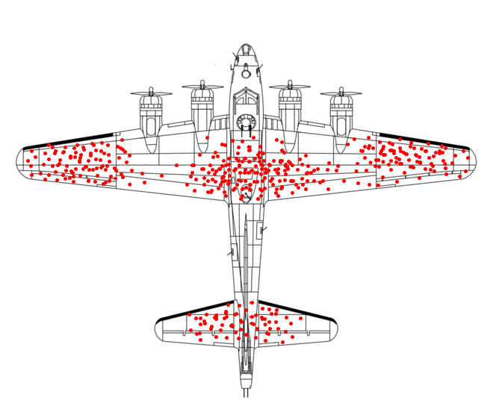
Vulnerabilities
Weak points in our attack surface
Outdated systems, bad policy and procedures, poor user habits
What are the
vulnerable areas
on this airplane?

Slide 10
Risks
Risk = (Threats * Vulnerabilities * Probability * Impact)/Countermeasures
How bad is it if we are compromised?
Risk tolerance - The level of risk an entity is willing to assume in order to achieve a potential desired result.
https://www.sans.org/blog/insider-threat-risk-formula-survivability-risk-and-threat/
https://csrc.nist.gov/glossary/term/risk_tolerance

Slide 11
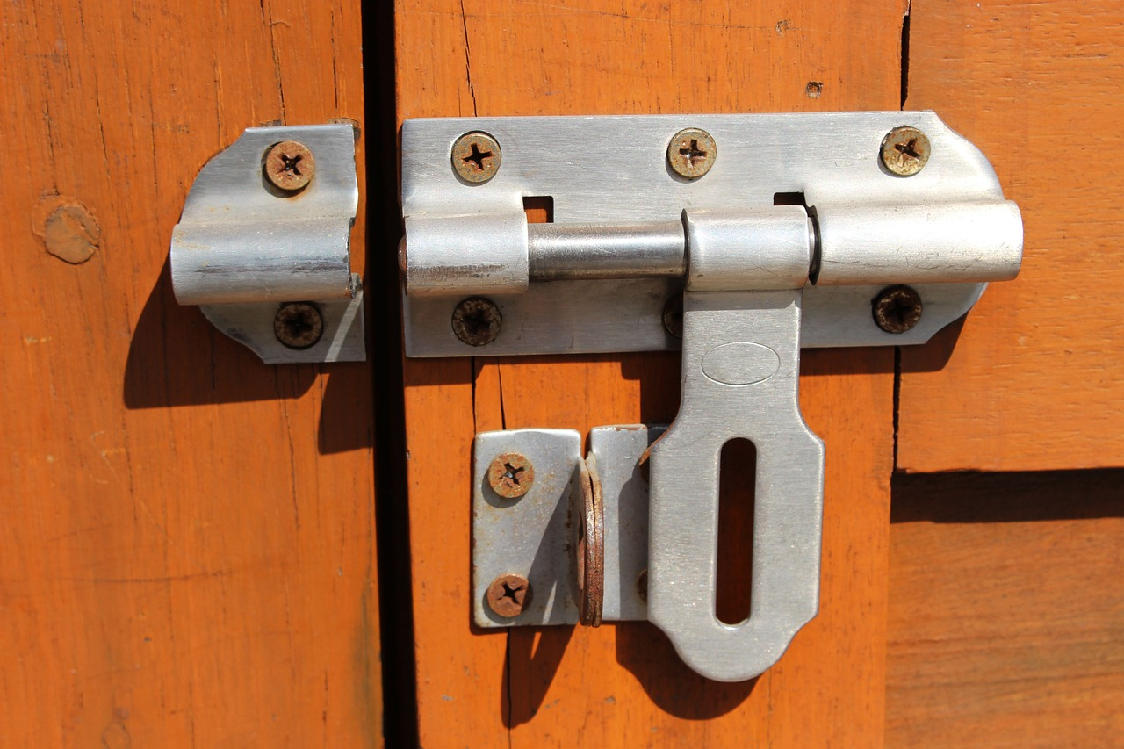


All Together now
Vulnerability Threat Risk

